Slide 1
Public Schools Transportation Allotment
Kevin Harrison, Section Chief
Transportation Services
NC Department of Public Instruction

Slide 2
Budget Bill Changes to Funding
Efficiency must be used to determine funding
The SBE must use the most recently available data to determine efficiency
All funds except 5% must be allocated at the beginning of the year
  For this year October worked (because we had 22-23 expenditure data together by that point)
  For next year, if it must be July, we would not have complete data
Reserve can only be used for ‘emergencies’
  We understand the following are no longer permitted as contingency allotments in the year
    Early College (CIHS), Regional/Lab Schools, and Highway Use Tax
  Equipment and Fuel contingency may remain (emergency need)
Any reserve funds remaining to be allotted April 1

Slide 3
Remaining Transportation Allotments
Stop Arm Camera Grants
  $690,000 recurring continues
Stop Arm Technology Grants
  $370,758 non-recurring
Equipment Contingency
  Unusual loss repairs / high-cost repair items such as engines and transmissions
April 1 Disbursement

Slide 4
Stop Arm Camera Funds
SBE Allotment Policy PRC 087
Funds Available: $690,000 recurring
Covers All LEAs
  Per original money report covering SL 2013-360 (There was no special provision)
Application Style: Survey-based responses
Survey went out this week

Slide 5
Additional Details
Qualifying Systems:
  Camera system which includes a stop arm camera
  System must be of a style which attempts the capture of images to identify the driver of the vehicle committing the violation
Allocation:
  2 per requesting LEA
  Remaining funds to be allocated to fund more systems in LEAs with lower fleet saturation
Allotment Amount:
  At the dollar value per system requested to a maximum of $3,000 per camera system

Slide 6
Stop Arm Technology Grants
SBE Allotment Policy PRC 087
Funds Available: $370,758 non-recurring
Covers All PSUs with School Buses
  Per the Special Provisions SL 2023-134
Application Style: Fillable application with PSU leadership signatures
Note: Report to the GA on many things including unmet needs.

Slide 7
Additional Details
Qualifying Systems:
  Extended Stop Signal (60” Min Extension)
  Illuminated Stop Signal (LED)
Allocation Factors:
  Type and number of additions, updates, or replacements proposed
  Number of bus routes or stops known to pose significant safety risk
  State Superintendent to Award
Allotment Amount:
  Dependent on Request
Special Provision:
  If the technology is not currently in the State Term Contract 071C or listed in allowed alterations of school bus equipment (SBE TRAN-005)
    The LEA must agree to pilot the technology and provide data

Slide 8
Equipment Contingency
To be allotted in PRC 056
Application: Spreadsheet and document submission to DPI Transportation Services
Allocation:
  LEAs providing documented significant and unusual failures of vehicle equipment
  Priority to acts of nature, major vandalism, and uncompensated collision repairs
  Priority to small and low wealth districts excess expenses
Allotment:
  Expected to be a percentage of the requested amount with priority districts receiving a larger percentage of documented losses

Slide 9
Additional Details
Qualifying Repairs:
  Over $2,000 for a single item or loss repair
    Cannot combine unrelated repairs to try and meet
Items not qualifying
  Routine/Regular Repairs
  Local Labor costs
  Stocked parts
  Fluids, tools, belts and other small parts and inventory items
  Any items covered under warranty

Slide 10
April 1 – Reserve Allocation
PRC 056
Allocation
  Per G.S. 115C 240(e) as revised by SL 2023-134
  All local school administrative units (LSAUs) based on the efficiency of the LSAUs in transporting pupils
Allotment Amount: Dependent on other distributions (potentially up to 2-3%)
At this point all funds will be distributed and no further funds will be available until July 2024

Slide 11
2024-2025 Funding
Need Discussion and Feedback

Slide 12
2024 – 2025 Funding
First Thoughts
Issue: All funds except 5% must be allocated at the beginning of the year. We don’t have complete data from 23-24 in June/July
Initial Thought:
Use best-available data as of mid-June
  State and Local expenditures in Fund 1 and Fund 2 PRC 056
  23-24 TD-2 (student ridership) and TD-10 (buses operated)
  Transportation budget rating simulator rating to produce initial allotments
Include estimated legislated adjustments if available
  Again based on best available object code data at the time
Use final 23-24 data as confirmed by TD-1 reporting to do an October/November update and create a new model
  Issue adjustments accordingly across the board still using the best of the two models as in the past

Slide 13
First Thought Pros
Since DPI has quantity of buses and students updated for 23-24 by this point (June), the LEA will have a funding number that is partially informed by new data
This will mean the initial allotment is closer to the end result
We can hit July

Slide 14
First Thought Cons
This information is dependent on LEA financial staff having actual expenditures as correct as possible by what DPI receives in June covering through May
It will be closer if the data is good
If the data is not accurate there will problems
Biggest Concern:
If the LEA places expenditures in fund 2 PRC 056 which they cannot (improper) or do not claim on the TD-1; OR
If the LEA recodes significant amounts of expenditures in the final 13P OUT of these or even just personnel cost objects
Then it is possible the October/November adjustment could be negative
If they code/recode significant amounts INTO these, then there may not be sufficient reserve to fully adjust

Slide 15
Invitation to Discuss
Legislative changes have altered the landscape
Would love to have a subcommittee or subgroup to discuss
  How best to adapt to the new requirements
  If the changes are the right direction or if we need to request some tweaks

Slide 16
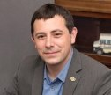
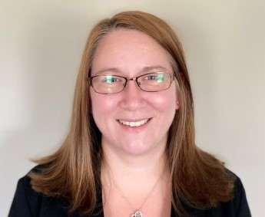

Transportation Office Staff
Kevin Harrison – Section Chief
Kevin.Harrison@dpi.nc.gov
984-236-2932
Jaime Doran – Program Analyst II
Jaime.Doran@dpi.nc.gov
984-236-2953
Brandon Arrington– Business Systems Analyst I
Brandon.Arrington@dpi.nc.gov
984-236-2935
Brandon Smith - Financial and Business Compliance Analyst II
Brandon.Smith@dpi.nc.gov
984-236-2934

Slide 17


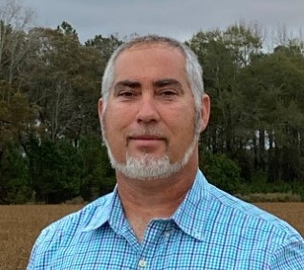
Transportation Field Consultants
Anthony Avant – Central Region
Anthony.Avant@dpi.nc.gov
336-848-4557
Danny Reed – Western Region
Danny.Reed@dpi.nc.gov
980-505-2537
Shannon Ennis – Eastern Region
Shannon.Ennis@dpi.nc.gov
919-625-0947

Slide 18

www.ncbussafety.org
This Photo by Unknown Author is licensed under CC BY-NC

Slide 19

This Photo by Unknown Author is licensed under CC BY-SA

