Slide 1
A Review of Laws and Policies Affecting Pupil Transportation for North Carolina LEAs
Kevin Harrison
Section Chief, Transportation Services
North Carolina Department of Public Instruction

Slide 2

Public School Laws Governing Pupil Transportation
This Photo by Unknown Author is licensed under CC BY-NC-ND

Slide 3

NC General Statute §115C
Applies to LEAs
Does not apply to private schools or charter schools
This Photo by Unknown Author is licensed under CC BY
NOTE: This presentation is a review of Statute, Rules, and Policy. It is a guide for what exists, not a full analysis or interpretation of the original texts and the full text should always be consulted with a local BOE attorney.

Slide 4
References
115C Public School Law
  Article 17 Supporting Services
20 Motor Vehicle Law
SBE Policy (TRAN-000 through TRAN-011)
SBE Transportation Rules (16 NCAC 06B)

Slide 5
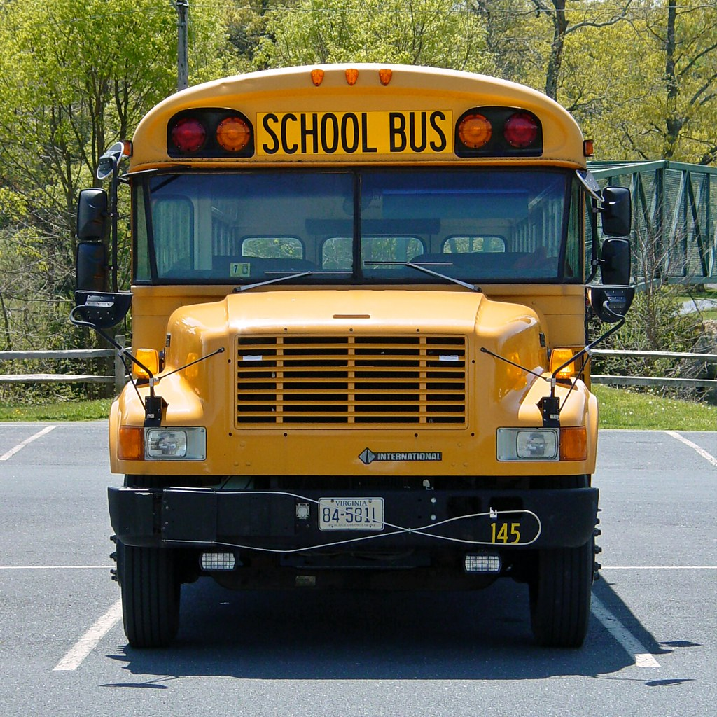
§115C-239 Authority of Local Boards of Education
LEAs can acquire and operate school buses for the transportation of enrolled pupils and employed staff
This Photo by Unknown Author is licensed under CC BY-SA

Slide 6
§ 115C-240. Authority and duties of State Board of Education
Promulgate rules and regulations for operation of the public school transportation system
Create rules and regulations for school bus specifications and maintenance
Create guidelines for routing; TIMS (or SBE approved equivalent)
Assist with questions of the local boards
Funds only to be used for replacing, maintaining, insuring, and operating school buses and service vehicles (in accordance with certain 115C laws and SBE rules)
SBE not obligated to provide transportation nor liable for what local boards do

Slide 7
§ 115C-240 Continued!
Allocate funds to LEAs based on LEA’s efficiency in transporting pupils
  Based on pupils transported, length of routes, road conditions and all other circumstances
  Fair and equitable basis according to needs
  Based on the most recently available data from a prior school year
Initial allotment of at least 95% of the available funds
Reserved funds to be allocated only in an emergency
All reserve funds remaining on April 1 to be allocated across all districts based on efficiency

Slide 8
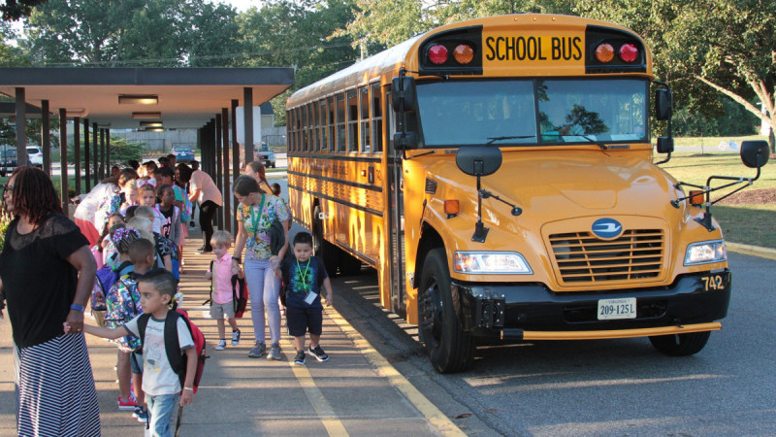
§115C-241. Assignment of school buses to schools
Superintendent of the LEA assigns the buses to be operated at each school
This Photo by Unknown Author is licensed under CC BY-NC

Slide 9
§115C-242. Use and operation of school buses.
Duty of the local Superintendent to supervise use and require compliance
Only for students enrolled in and employees of the school
Limited to transportation to and from school for the “regularly organized school day”
  To-From points designated for receiving and discharging
  NC Pre-K or Head Start program (at the program’s cost)
  Private school if LEA places student with disability there
Not required for students living within 1.5 miles
Not required for employees

Slide 10
§115C-242. Use and operation of school buses.
Other Uses:
  Illness or Injury requiring immediate medical attention (staff or students)
  One day prior to opening of school
  To serve the instructional purposes of the school
  Emergency management uses in declared state or local emergency
  Testing EM plans but not at state/local board expense
  Senior Citizens Groups as permitted in 115C-243 (At group’s expense)
    Note: 115C-243 has a lot of specific rules

Slide 11
§115C-242.1 School Bus Safety Cameras
Allows for automated school bus safety cameras
  §20-217 - Criminal Violations of Stop Arm Law
  §153A-246 - Civil violations by a vehicle of stop arm law ordinance
Allows for the photographs or videos to be provided to law enforcement for use as evidence

Slide 12
§115C-244. Assignment of pupils to school buses.
Responsibility of superintendent
Any pupil may apply for transportation for the “regularly organized school day”
  Appeal is to the local board of education
    If entitled OR the assignment will not be detrimental to students or safe and efficient operations, then the board shall direct it to be done
  BoE decision is subject to judicial review in superior court of the county
Employees riding can’t displace or prevent assignment of students to a bus or be detrimental to students or operations

Slide 13
§ 115C-245. School bus drivers; monitors; safety assistants
LEA shall employ drivers
Driver must meet all qualifications
Driver has responsibility for operation and keeping good order and conduct
  Report to principal any misconduct or disregard of driver instructions
No one can ride unless authorized by the Superintendent (or designee)
Monitors – unpaid volunteers to help preserve order
Transportation Safety Assistants – Staff to help with safety and care of children

Slide 14
§ 115C-246. School bus routes
Superintendent, or designee, responsible for school bus routes
Unless conditions warrant, use state-maintained roads, city streets, or other streets with public right-of-way.
Not responsible for damage to the roadway (whether public or not)
Stop within one mile of the residence of each pupil assigned
If they’re 1.5 miles or more from the school they shall be eligible (though you can transport closer students as well)
All routes filed at LEA and changes documented within 10 days
No duty to transport within corporate limits of city or town even if those outside are transported

Slide 15
§ 115C-247. Purchase of activity buses by local boards
Authorized to own and operate activity buses
  “to and from athletic events and for other local school activity purposes”
Local board shall adopt a policy for proper use of the vehicles. The policy shall permit use for athletic events during the regular season and playoffs and to other school-sponsored activities
LEA can have insurance for these

Slide 16
§115C-248. Inspection of school buses and activity buses; report of defects by drivers; discontinuing use until defects remedied.
Superintendent shall cause each bus to be inspected every 30 days; report of findings documented and filed
Driver must report defects promptly
Principal or superintendent must remove from service if not safe
Same standards apply to Activity Buses
No use of State funds for Activity Buses reitterated

Slide 17
§ 115C-249. Purchase and maintenance of school buses, materials and supplies.
LEA may purchase additional school buses
Tax-levying authorities authorized to make provision in capital budget
Funds appropriated by G.A. allocated to local boards of education
  20+ years – 150k miles
  15-19 years – 250k miles
  Less than 15 years – 300k miles
  May receive $2000 in lieu of replacement that year
  Some additional with safety concerns
Title to the local board of education

Slide 18
§ 115C-249. Purchase and maintenance of school buses, materials and supplies.
County supplies buildings and equipment for storage and maintenance of buses of all LEAs in the county
Damage or destruction – LEA may apply to the state for funds to replace
Appropriations shall not revert

Slide 19
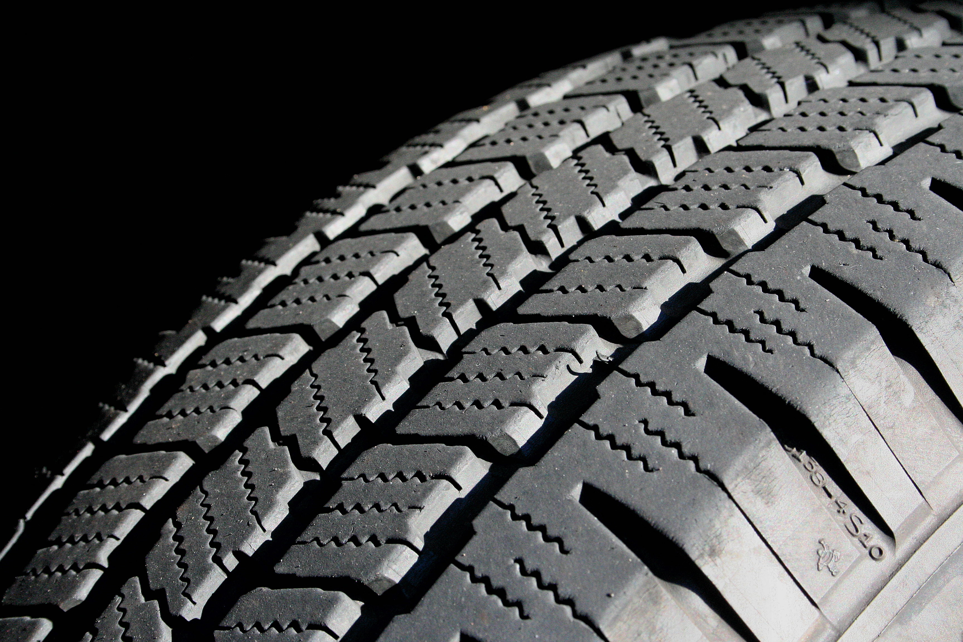
§ 115C-249.1 Purchase of tires for school buses; repair or refurbishment of tires for school buses.
LEA must purchase tires that posses the original unaltered and uncovered tire sidewall.
This Photo by Unknown Author is licensed under CC BY-SA

Slide 20
§ 115C-250. Transportation of children with disabilities
Funds can be used to transport students that cannot, due to a disability, ride regular school buses
DHHS can spend funds for this as well if they place the student in a program
Local area mental health center must pay if they place a student
Funds from EC can be used to pay for transportation safety assistants when students with disabilities are assigned to the bus

Slide 21
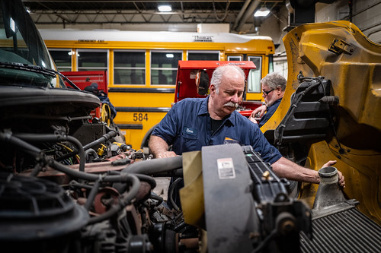
§ 115C-251. Transportation Supervisors
SBE can adopt minimum qualifications for chief mechanics or supervisors of transportation
This Photo by Unknown Author is licensed under CC BY-NC-ND

Slide 22
§ 115C-252. Aid in lieu of transportation
$50 per month for boarding if it’s impracticable to transport and thus the student has to obtain lodging closer to the school
  Clearly inflation has not been kind to this 1955 statute ☺
Allows reassignment of students to different schools based on transportation
Establishes student’s right to remain in their existing school without the benefit of transportation

Slide 23
§ 115C-253. Contracts for transportation.
LEA may contract for transportation of pupils (individuals, firms, or corporations)
Vehicles constructed and drivers with all qualifications as required by the State Board
Vehicles under 16 passengers don’t have to meet school bus equipment requirements; instead, other rules as adopted by State Board of Education
Can use school bus operations funds for such contract transportation

Slide 24
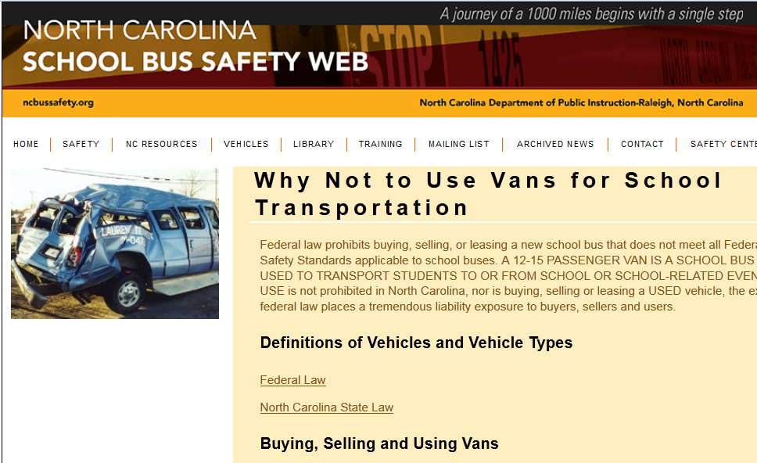
12-15 Passenger Vans
http://www.ncbussafety.org/vans

Slide 25
§ 115C-254. Use of school buses by State militia or national guard
North Carolina State Defense Militia or the national guard to transport their members
Expenses paid by the Militia or the guard

Slide 26
§115C-255. Liability insurance and waiver of immunity as to certain acts of bus drivers.
Ref – 115C-42 applicable except when vehicles are operated with funds from State Public School Fund;
115C-42 is regarding waiving governmental immunity w/ the purchase of insurance
  Limits liability to amount of insurance in those instances

Slide 27
§115C 256-262
§115C-256. School bus drivers under Workers' Compensation Act.
§ 115C-257. Attorney General to pay claims
  Medical up to $3000 for pupils injured
§115C-258. Provisions regarding payment
  Regardless of liability or negligence
§115C-259. Claims must be filed within one year
§115C-262. Liability insurance and tort liability (subject to 115C-42)

Slide 28
115C-105.41 Students At-Risk of Academic Failure
Formerly this required personal education plans for some students and transportation for all students to implement those plans at no cost to students.
These components were removed in 2015.

Slide 29
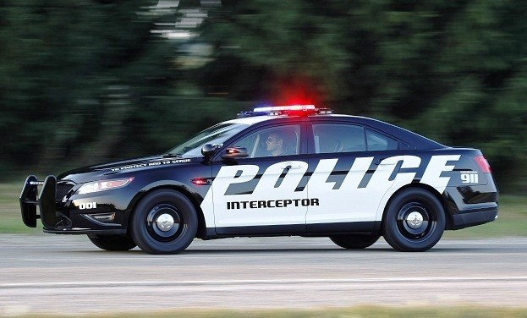
Motor Vehicle Laws
Impacting Pupil Transportation
This Photo by Unknown Author is licensed under CC BY-NC

Slide 30
§ 20-4.01. Definitions
d3. School activity bus. - A vehicle, generally painted a different color from a school bus, whose primary purpose is to transport school students and others to or from a place for participation in an event other than regular classroom work. The term includes a public, private, or parochial vehicle that meets this description.
d4. School bus. - A vehicle whose primary purpose is to transport school students over an established route to and from school for the regularly scheduled school day, that is equipped with alternately flashing red lights on the front and rear and a mechanical stop signal, that is painted primarily yellow below the roofline and that bears the plainly visible words "School Bus" on the front and rear. The term includes a public, private, or parochial vehicle that meets this description.

Slide 31
§ 20‑137.4
Unlawful use of a mobile phone.
Covers more than you think
  School and Activity Buses
  “any vehicle transporting public, private, or parochial school students for compensation”
“no person shall operate a school bus on a public street or highway or public vehicular area while using a mobile telephone or any additional technology associated with a mobile telephone while the school bus is in motion.”
EXCEPT for the sole purpose of communicating in an emergency situation.
Class 2 misdemeanor

Slide 32
§ 20-217. Motor vehicles to stop for properly marked and designated school buses in certain instances; evidence of identity of driver.
When drivers have to stop
Covers Public and Private school buses
Penalties of increasing severity to offenders
Cameras can be used as evidence to prosecute violations
Unlawful to have students cross where traffic doesn’t have to stop (unlawful for driver and unlawful for principal/SI to authorize the driver to do so)

Slide 33
§ 20-218. Standard qualifications for school bus drivers; speed limit for school buses and school activity buses.
No one can drive a school bus with child passengers in NC unless:
  Hold a certificate from DMV Commissioner and Director of Transportation or designees
    Examined the driver
    Fit and competent to drive
School bus drivers:
  At least 18 years
  Class A, B, C commercial driver’s license
  School bus driver’s certificate as above
Activity bus drivers
  Same OR license appropriate for the class of vehicle
  Allows CDL w/ P and S endorsement holders to drive without a certificate potentially
  Allows small (14 passenger + driver) buses to be driven by a non-commercial license holder
Speed Limits while occupied by students
  45 Mph School Bus
  55 Mph Activity Bus
Any violation – Class 3 misdemeanor

Slide 34
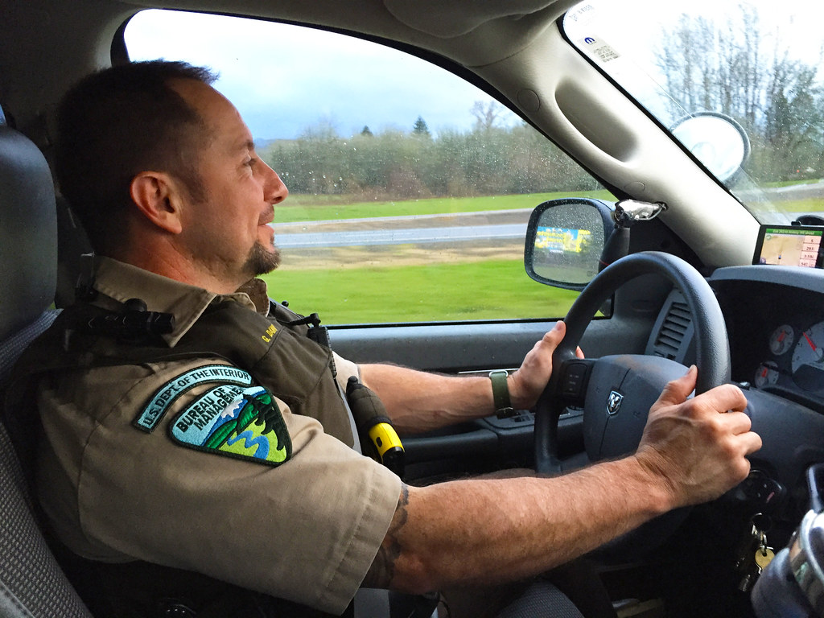
Other State Laws
This Photo by Unknown Author is licensed under CC BY

Slide 35
§ 14-132.2. Willfully trespassing upon, damaging, or impeding the progress of a public school bus.
Class 1 misdemeanor to
  demolish, destroy, deface, injure, burn or damage school bus or activity bus
  enter school bus or activity bus after being forbidden to do so by the authorized school bus driver in charge
  Occupant of a bus that shall refuse to leave
b and c do not apply to those under 12

Slide 36

§ 14-33. Misdemeanor assaults, batteries, and affrays, simple and aggravated; punishments.
Class A1 misdemeanor – Assaulting a school employee while conducting duties in school transportation
This Photo by Unknown Author is licensed under CC BY-SA-NC

Slide 37
G.S. 66-58 Article 11. Government in Business (The Umstead Act)
§ 66-58. Sale of merchandise or services by governmental units.
(a) Except as may be provided in this section, it shall be unlawful for any unit, department or agency of the State government, or any division or subdivision of the unit, department or agency, or any individual employee or employees of the unit, department or agency in his, or her, or their capacity as employee or employees thereof, to engage directly or indirectly in the sale of goods, wares or merchandise in competition with citizens of the State, or to engage in the operation of restaurants, cafeterias or other eating places in any building owned by or leased in the name of the State, or to maintain service establishments for the rendering of services to the public ordinarily and customarily rendered by private enterprises, or to provide transportation services, or to contract with any person, firm or corporation for the operation or rendering of the businesses or services on behalf of the unit, department or agency, or to purchase for or sell to any person, firm or corporation any article of merchandise in competition with private enterprise. The leasing or subleasing of space in any building owned, leased or operated by any unit, department or agency or division or subdivision thereof of the State for the purpose of operating or rendering of any of the businesses or services herein referred to is hereby prohibited.

Slide 38
(b) The provisions of subsection (a) of this section shall not apply to:
……..
(10) Child-caring institutions or orphanages receiving State aid.
(11) Highlands School in Macon County.
(12) The North Carolina State Fair.
…..

Slide 39
(c) The provisions of subsection (a) shall not prohibit:
(9) The operation by the public schools of school cafeterias.
(9a) The use of a public school bus or public school activity bus for a purpose allowed under G.S. 115C-242 or the use of a public school activity bus for a purpose authorized by G.S. 115C-247.
(9b) The use of a public school activity bus by a nonprofit corporation or a unit of local government to provide transportation services for school-aged and preschool-aged children, their caretakers, and their instructors to or from activities being held on the property of a nonprofit corporation or a unit of local government. The local board of education that owns the bus shall ensure that the person driving the bus is licensed to operate the bus and that the lessee has adequate liability insurance to cover the use and operation of the leased bus.

Slide 40
§ 143-300.1 - Tort Claims
School buses and vehicles servicing school buses for 115C-242 purposes
The driver is an employee of the county or city administrative unit of which that board is the governing body, and the driver is paid or authorized to be paid by that administrative unit
  OR a driver trainee under DMV or LEA trainer supervision
Monitors, Safety Assistants, and Techs
$1 million per individual recovery max

Slide 41
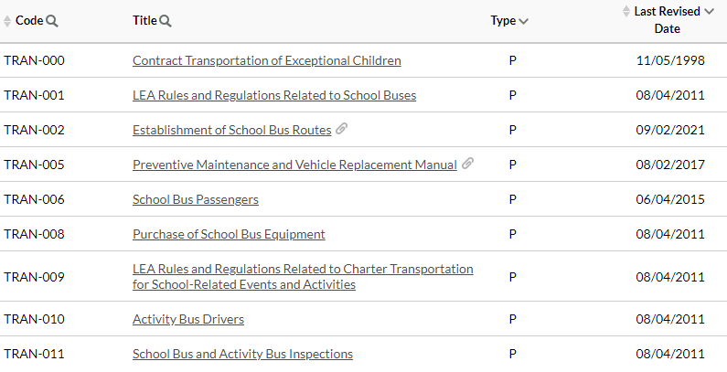
State Board of Education Policies

Slide 42
TRAN-000 – Contract Transportation for EC
Pretty old and may need revision
Lays out the ideas and rules when transporting students differently due to an IEP, and making that transportation efficient and on good legal ground.
EC Transportation Safety Assistants shall not be paid from PRC 056

Slide 43
TRAN-002 – School Bus Routes
PSU must establish school bus routes for all students eligible for and requesting transportation
Bus routes shall be planned in a manner designed to conserve fuel and to use buses efficiently.
Unless safety or other conditions make it inadvisable
  Don’t deviate for less than half a mile unless
    10+ students, unescorted PK-3 students, or IEP
  Don’t plan bus stops closer together than 0.2 miles
Must inform parents of the scheduled school bus arrival time and their responsibility to assure students are at the stop prior to that time.

Slide 44
TRAN-002 – School Bus Routes
“Implement TIMS”
  Establish all school bus routes in TIMS
Can use any number of additional systems as desired
PSU Superintendent can request evaluation of a school bus routing system for equivalency
Eval based on:
  SIS data import in standard format
  Essential computer-assisted school bus routing functions
  Output standard data elements which align with TIMS
    Demonstrated from the new system using PSU data
SBE Action Item
Upon approval – Department will issue a letter to the PSU

Slide 45
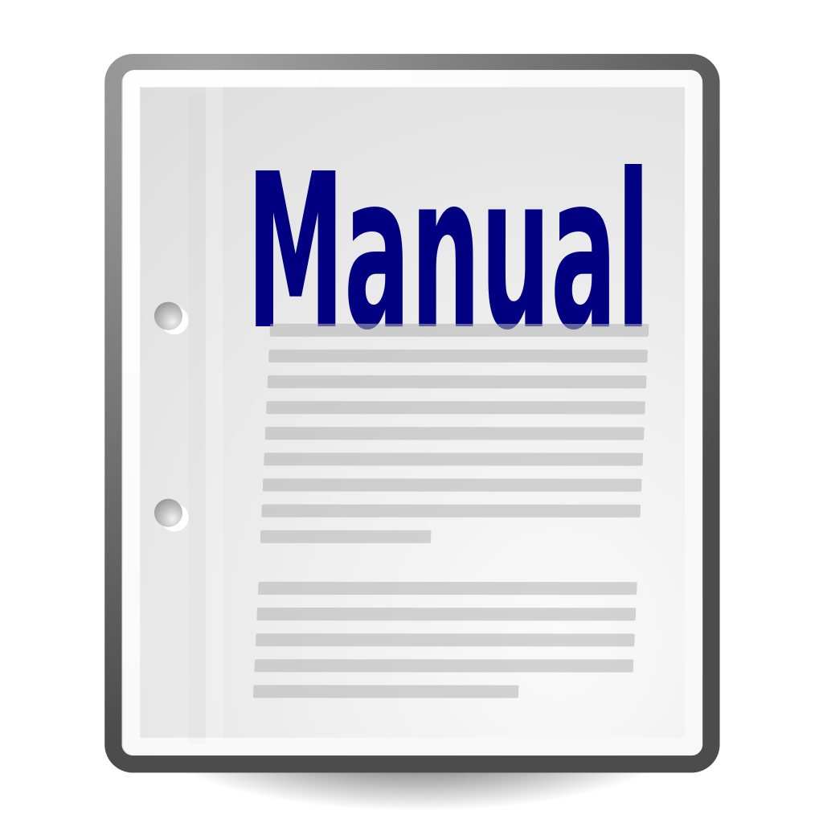
TRAN-005 – Preventive Maintenance and Vehicle Replacement Manual
Covers many necessary pieces of information regarding vehicles, how they can be used or modified, our processes, and records keeping.
It also includes the 30-day inspection manual.
This Photo by Unknown Author is licensed under CC BY-SA

Slide 46
TRAN-009 – Charter Bus Transportation
Adopt standards
Maintain an approved list of companies / individuals meeting standards
Use the recommended guidelines or if less stringent note differences and indicate why the LEA is adopting a lesser standard
Can work with others to develop standards or certify companies / individuals

Slide 47
TRAN-010 – Activity Bus Drivers
LEA staff that drive an activity bus which requires a CDL
Have to have a school bus driver’s certificate too

Slide 48

TRAN-011 – Bus Inspections
Inspections are to be conducted by someone who has completed vehicle inspection training and certification requirements of DPI
This Photo by Unknown Author is licensed under CC BY-SA

Slide 49
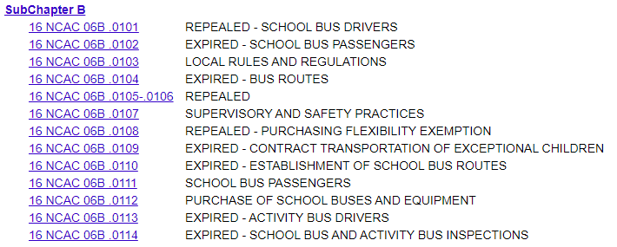
Administrative Rules

Slide 50
Basics
Administrative rules have the force of law
Enforceable by the Agency in Court
They interpret and define more specifics within statute within the Agency’s authority as determined by the Rules Review Commission
Law > Rules > Policy > Best Practices

Slide 51
TRAN-001 /16 NCAC 06B .0103 – Local Rules and Regs
LEA has to have policies!
  Use of school buses to support instructional purposes of schools (instructional trips via school bus)
  Uniform discipline system
  Procedures for recruitment and selection of drivers
  Procedures for relieving a driver of driving duties
  Passenger safety training and safety rules
  Responsibilities of school bus transportation safety assistants and monitors
  Duties of school personnel in the administration of the school transportation program.

Slide 52
16 NCAC 06B .0107 – Supervisory and Safety Practices
DPI may evaluate LEA transportation program
  Including supervisory and safety practices
DPI may make recommendations to the LEA

Slide 53
TRAN-006 / 16 NCAC 06B .0111
Instruct all children (regardless of whether they ride) within the first 5 days of school and at least once during each semester thereafter.
Document date training provided to each student
Shall include at least:
  Safe behaviors in and around school buses and stops
    Walking to and Waiting at
    Loading and Unloading
    NC Crossing signal
  Emergency exits for the specific vehicle used on that trip

Slide 54
TRAN-006 / 16 NCAC 06B .0111
School/Activity/Commercial/Contract Vehicles
  Shall not exceed official rated capacity
  All students seated in the seating compartments
  No standing or sitting in the aisle or stepwell
Drivers must use NC crossing signal
Instruction to students riding in activity buses or commercial buses including emergency exit operation for the specific vehicle

Slide 55
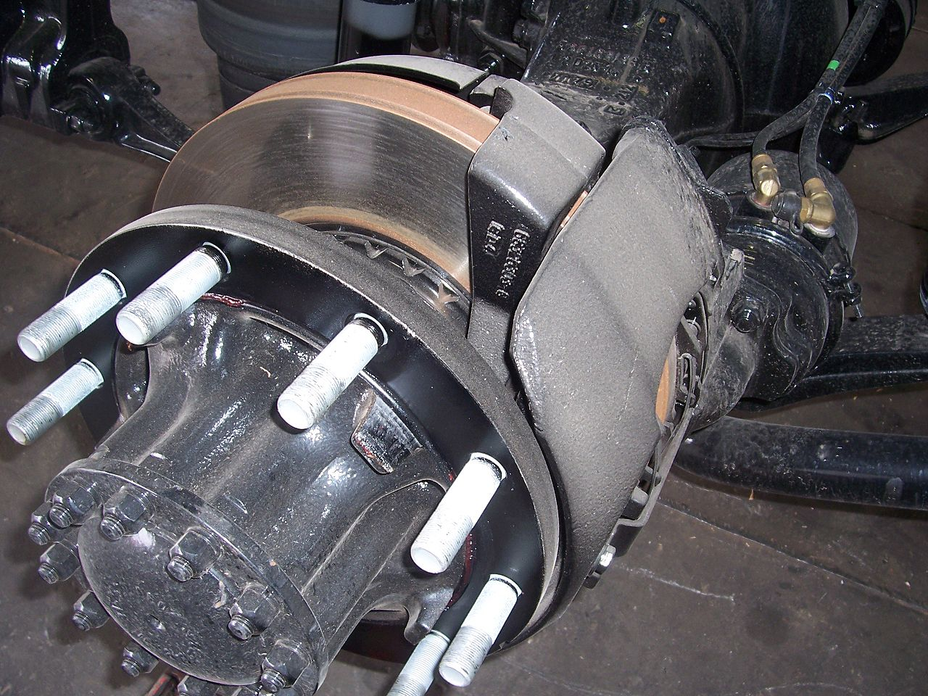
TRAN-008 /16 NCAC 06B .0112 -
Purchase of School Buses and Equipment
Local education agencies shall purchase school buses from the statewide term contracts approved by the Secretary of Administration under G.S. 143-49 and shall purchase school bus brake pads, brake shoes, and brake hardware that have the same specifications as the original equipment.
This Photo by Unknown Author is licensed under CC BY-SA

Slide 56



Transportation Field Consultants
Anthony Avant – Central Region
Anthony.Avant@dpi.nc.gov
336-848-4557
Danny Reed – Western Region
Danny.Reed@dpi.nc.gov
980-505-2537
Shannon Ennis – Eastern Region
Shannon.Ennis@dpi.nc.gov
919-625-0947

Slide 57

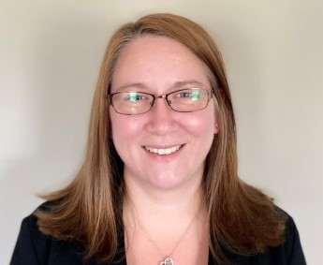

Transportation Office Staff
Kevin Harrison – Section Chief
Kevin.Harrison@dpi.nc.gov
984-236-2932
Jaime Doran – Program Analyst II
Jaime.Doran@dpi.nc.gov
984-236-2953
Brandon Arrington– Business Systems Analyst I
Brandon.Arrington@dpi.nc.gov
984-236-2935
Brandon Smith - Financial and Business Compliance Analyst II
Brandon.Smith@dpi.nc.gov
984-236-2934

Slide 58

www.ncbussafety.org
This Photo by Unknown Author is licensed under CC BY-NC

Slide 59

This Photo by Unknown Author is licensed under CC BY-SA

